Slide 1
JDBC (Java DataBase Connection)
Prepared by:
Omkar Dixit and Pratik Panchal

Slide 2
Table of Contents
Introduction on JDBC
Basics steps to be followed in any JDBC program
Difference between Statement and PreparedStatement
Transactions
Metadata
BLOB (Binary Large Objects) and CLOB (Character Large Objects)
Summary and Further Study.
Notes:
Omkar

Slide 3
Introduction
JDBC (Java DataBase Connection) is standard API which acts like an interface between java and database
JDBC
Database
JAVA
MySQL
MS SQL
Oracle
Postgres
Notes:
Omkar

Slide 4
Basic Steps in JDBC
Import the Package
Load and Register the driver for the database you want to work with. (automatically handled in JDBC version > 4.0)
Establish the connection.
Create the statement (sql query).
Execute the statement.
Process the ResultSet (incase of DQL).
Close the connection.
Notes:
Omkar

Slide 5
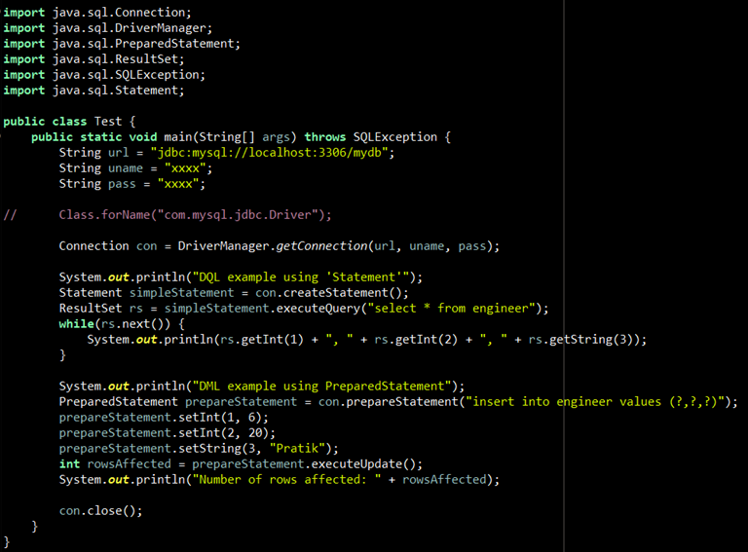
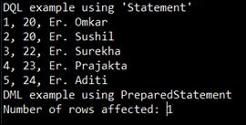
Sample JDBC program
OUTPUT
Notes:
Omkar

Slide 6
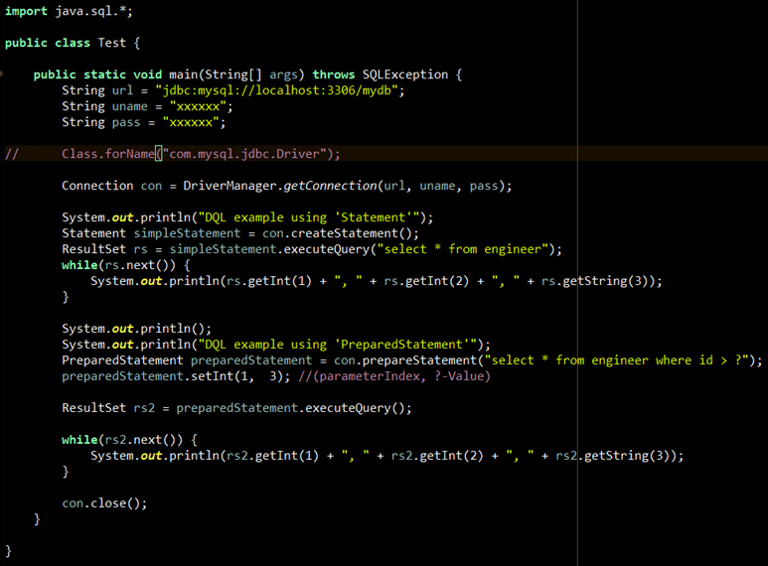
Step 1: Package Import & Step 2: Load Driver
Auto Handled in JDBC version 4.0 and above
Notes:
Omkar

Slide 7
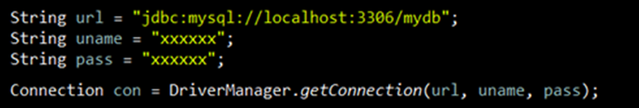
Step 3: Establish the Connection
Basic Syntax of JDBC URL
jdbc:<driver_protocol>:<driver_connection_details>
Example:
MS SQL Server → jdbc:odbc:DemoDSN
Oracle Server → jdbc:oracle:thin@myServer:1521:database
MySQL Server → jdbc:mysql://localhost:3306/database
Exception thrown by DriverManager.getConnection() method is ‘SQLException’
Notes:
Omkar

Slide 8
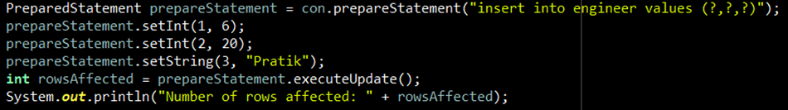

Step 4: Create the Statement
Types of statements
Exception:
SQLException
Query
Procedure Call
Statement
con.createStatement()
PreparedStatement
con.prepareStatement(“query”)
CallableStatement
con.prepareCall(“query”)
Notes:
Pratik

Slide 9
Step 5: Execute the Statement
Query Type
Exception:
SQLException
SQLSyntaxErrorException
DQL
DML
stmt.executeQuery()
-> returns ResultSet
stmt.execute()
-> returns boolean
stmt.executeUpdate()
-> returns int
While Using Statement Object pass query in execute Methods
Eg: Statement st = con.createStatement()
st.execute_____(“query here”);
While Using PreparedStatement or CallableStatement Object pass query in statement creation step
Eg: PreparedStatement st = con.prepareStatement(“query here”)
st.execute_____();
Notes:
Pratik

Slide 10
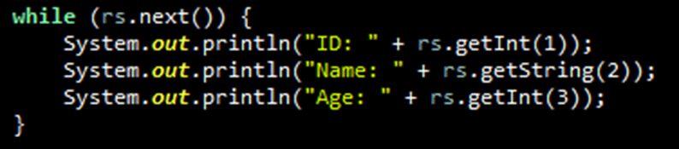
Step 6: Process the Result
ID (1) | Name (2) | Age (3)
1001 | Omkar | 22
1002 | Pratik | 23
ResultSet rs = stmt.executeQuery();
Exception:
SQLException0
int rowsAffected = stmt.executeUpdate();
boolean queryExecuted = stmt.execute();
Gives the number of rows affected.
Returns true, if the first result is a ResultSet object, else returns false. Further we can get ResultSet or number of rows affected by calling stmt.getResultSet() and stmt.getUpdateCount() methods respectively.
Notes:
Pratik

Slide 11

Step 7:Close the Connection
Exception:
SQLException0
Notes:
Pratik

Slide 12
Why PreparedStatement is better than Statement?
Statement | Prepared Statement
Slow | Fast
BLOB and CLOB is not supported | BLOB and CLOB is supported
Does not accept run time parameters | It accepts run time parameters
Vulnerable to SQL Injection attack | Prevents SQL Injection attack
Notes:
Pratik

Slide 13
Transactions
Database Transactions mechanism is very essential to ensure database consistency.
By default, auto Commit is set to true in Connection object
Methods used in case of transactions on Connection object are
con.setAutoCommit(false)
con.commit()
con.rollback()
Notes:
Omkar overview and me code

Slide 14
Metadata
Metadata in DBMS refers to the information that describes the schema and other information related to the stored data in the database.
In JDBC there are two type of Metadata; Database Metadata and ResultSet Metadata.
Database Metadata
ResultSet Metadata
It is used to get data related to database such as
Database name
Database Product Version
Driver Name
List of Tables, Views.
List of Databases
List of Columns
Etc.
It is used to get metadata of query output such as
Total Number of Columns
Column Names
Column Type
Is it set to auto increment
Is it set to nullable
Etc.
Notes:
Pratik

Slide 15
BLOB and CLOB
This are Special Datatypes used to store large object in database
BLOB
CLOB
Stands for Binary Large Objects
Datatype used in MySQL is ‘BLOB’
BLOB can store upto 64Kb file
InputStream is used to insert and read file
Stands for Character Large Object
Datatype used in MySQL is ‘LONGTEXT’
LONGTXT can store upto 4GB of characters
Reader is used to insert and read file
Notes:
Pratik

Slide 16
Packages and Classes
Java.sql Package
DriverManger
Connection
Statement
PreparedStatement
ResultSet
CallableStatement
Javax.sql Package
DataSource (for connection pooling)
Click Here for more details.
Notes:
Omkar

Slide 17
Thankyou
Any Questions?
Notes:
Omkar

